Slide 1
OLSP RC Primary School
SEND Information Report for Parents
(Reviewed Sept 2024)
If I am without love, I am nothing.” 1 Corinthians 13:2

Slide 2
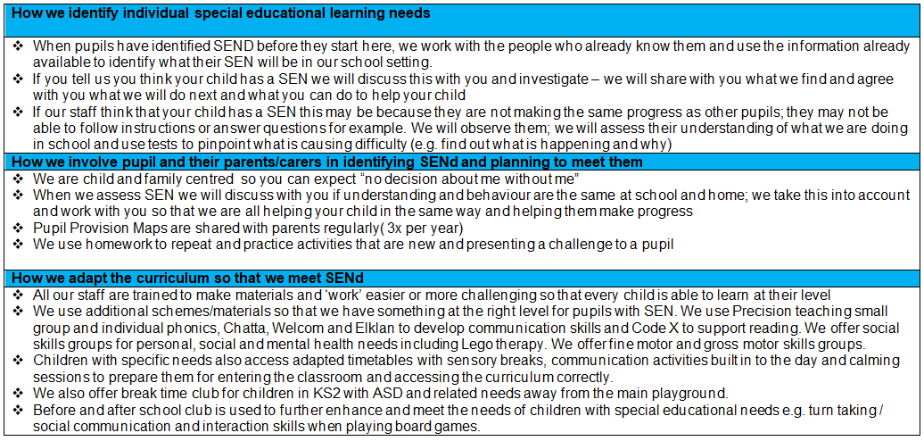
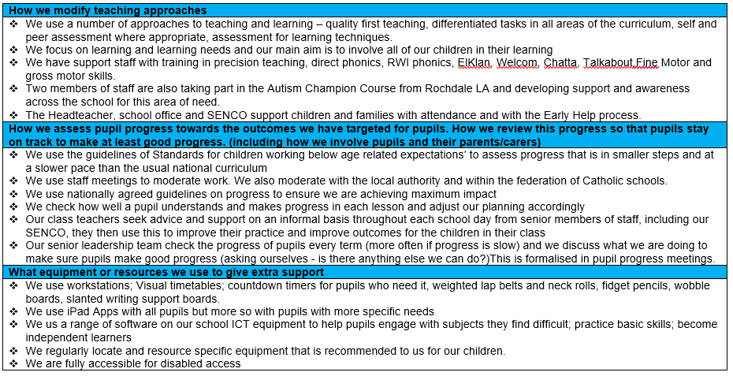
OLSP Offer

Slide 3
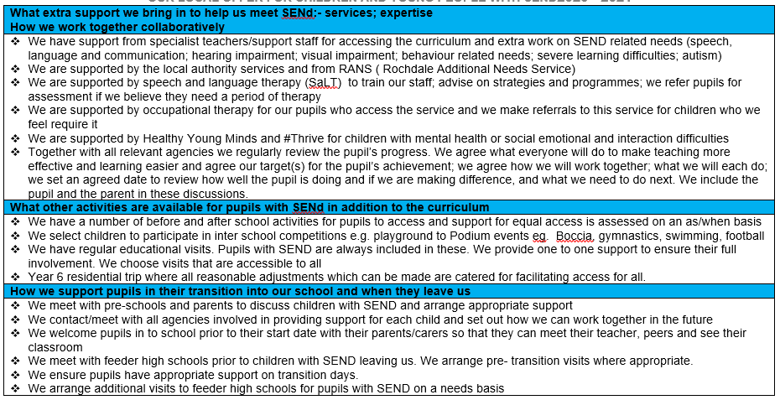
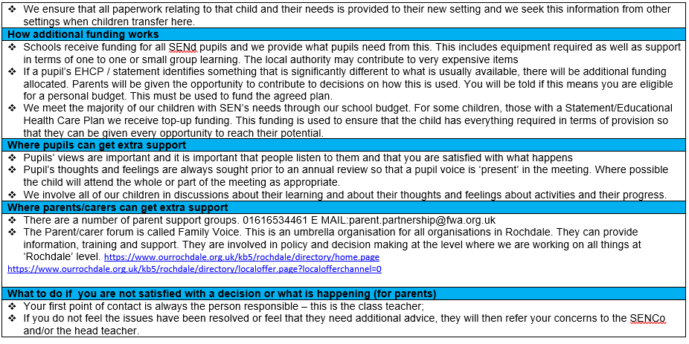
OLSP Offer

