Slide 1

Maths: Long Term Plans
‘If I am without love, I am nothing,’
1 Corinthians 13

Slide 2

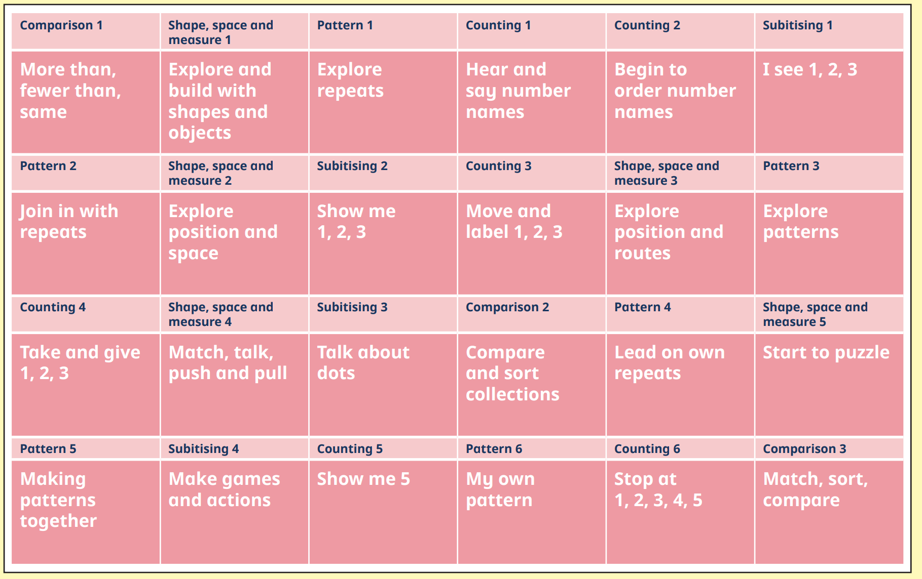
Nursery

Slide 3
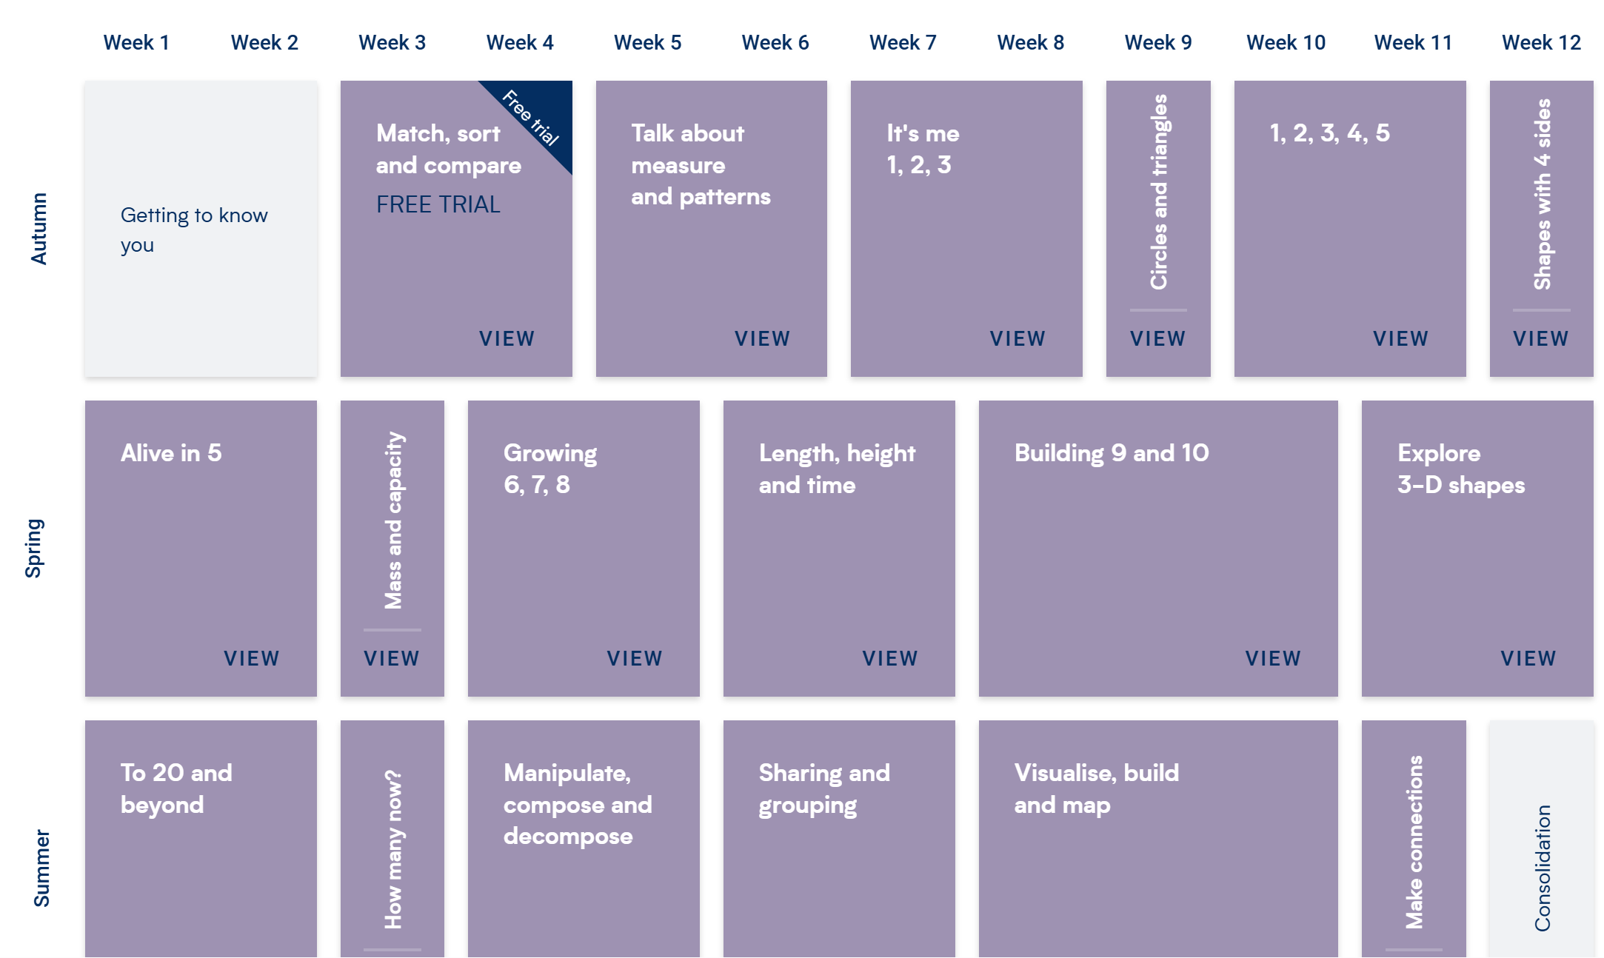
Reception

Slide 4
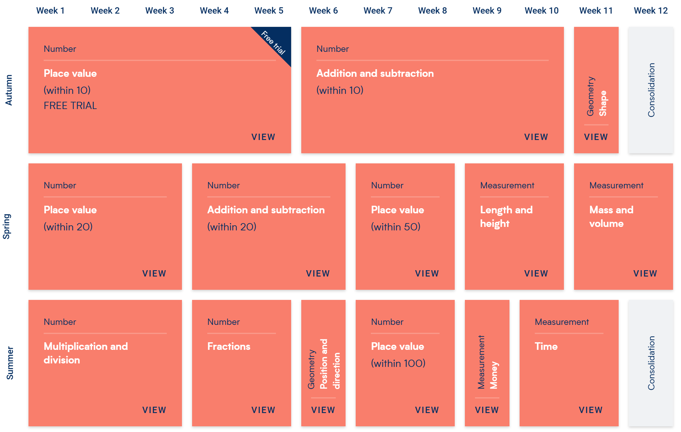
Year 1

Slide 5
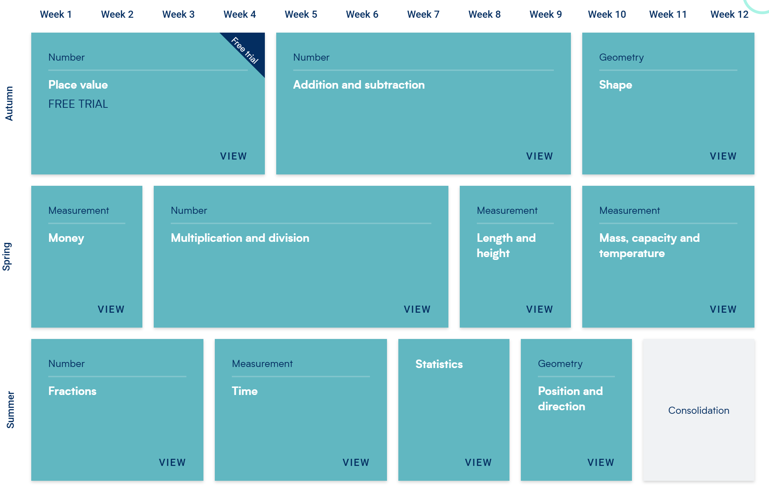
Year 2

Slide 6
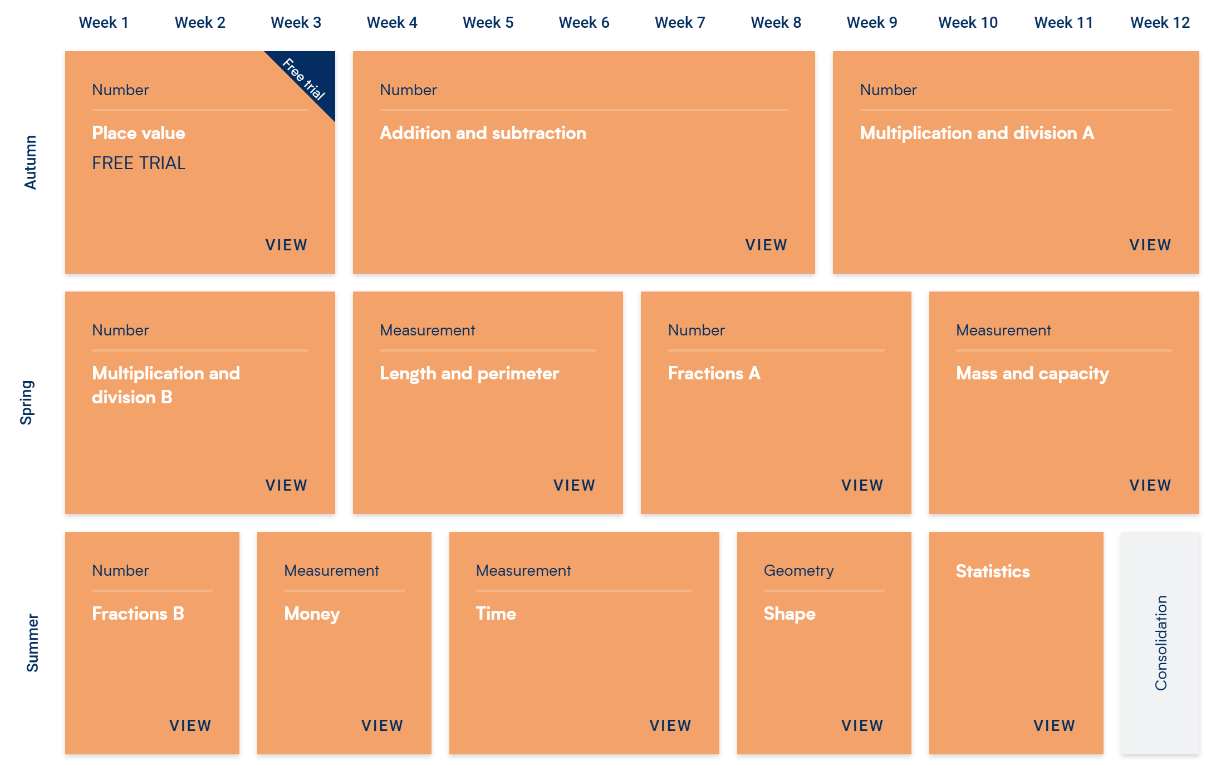
Year 3

Slide 7
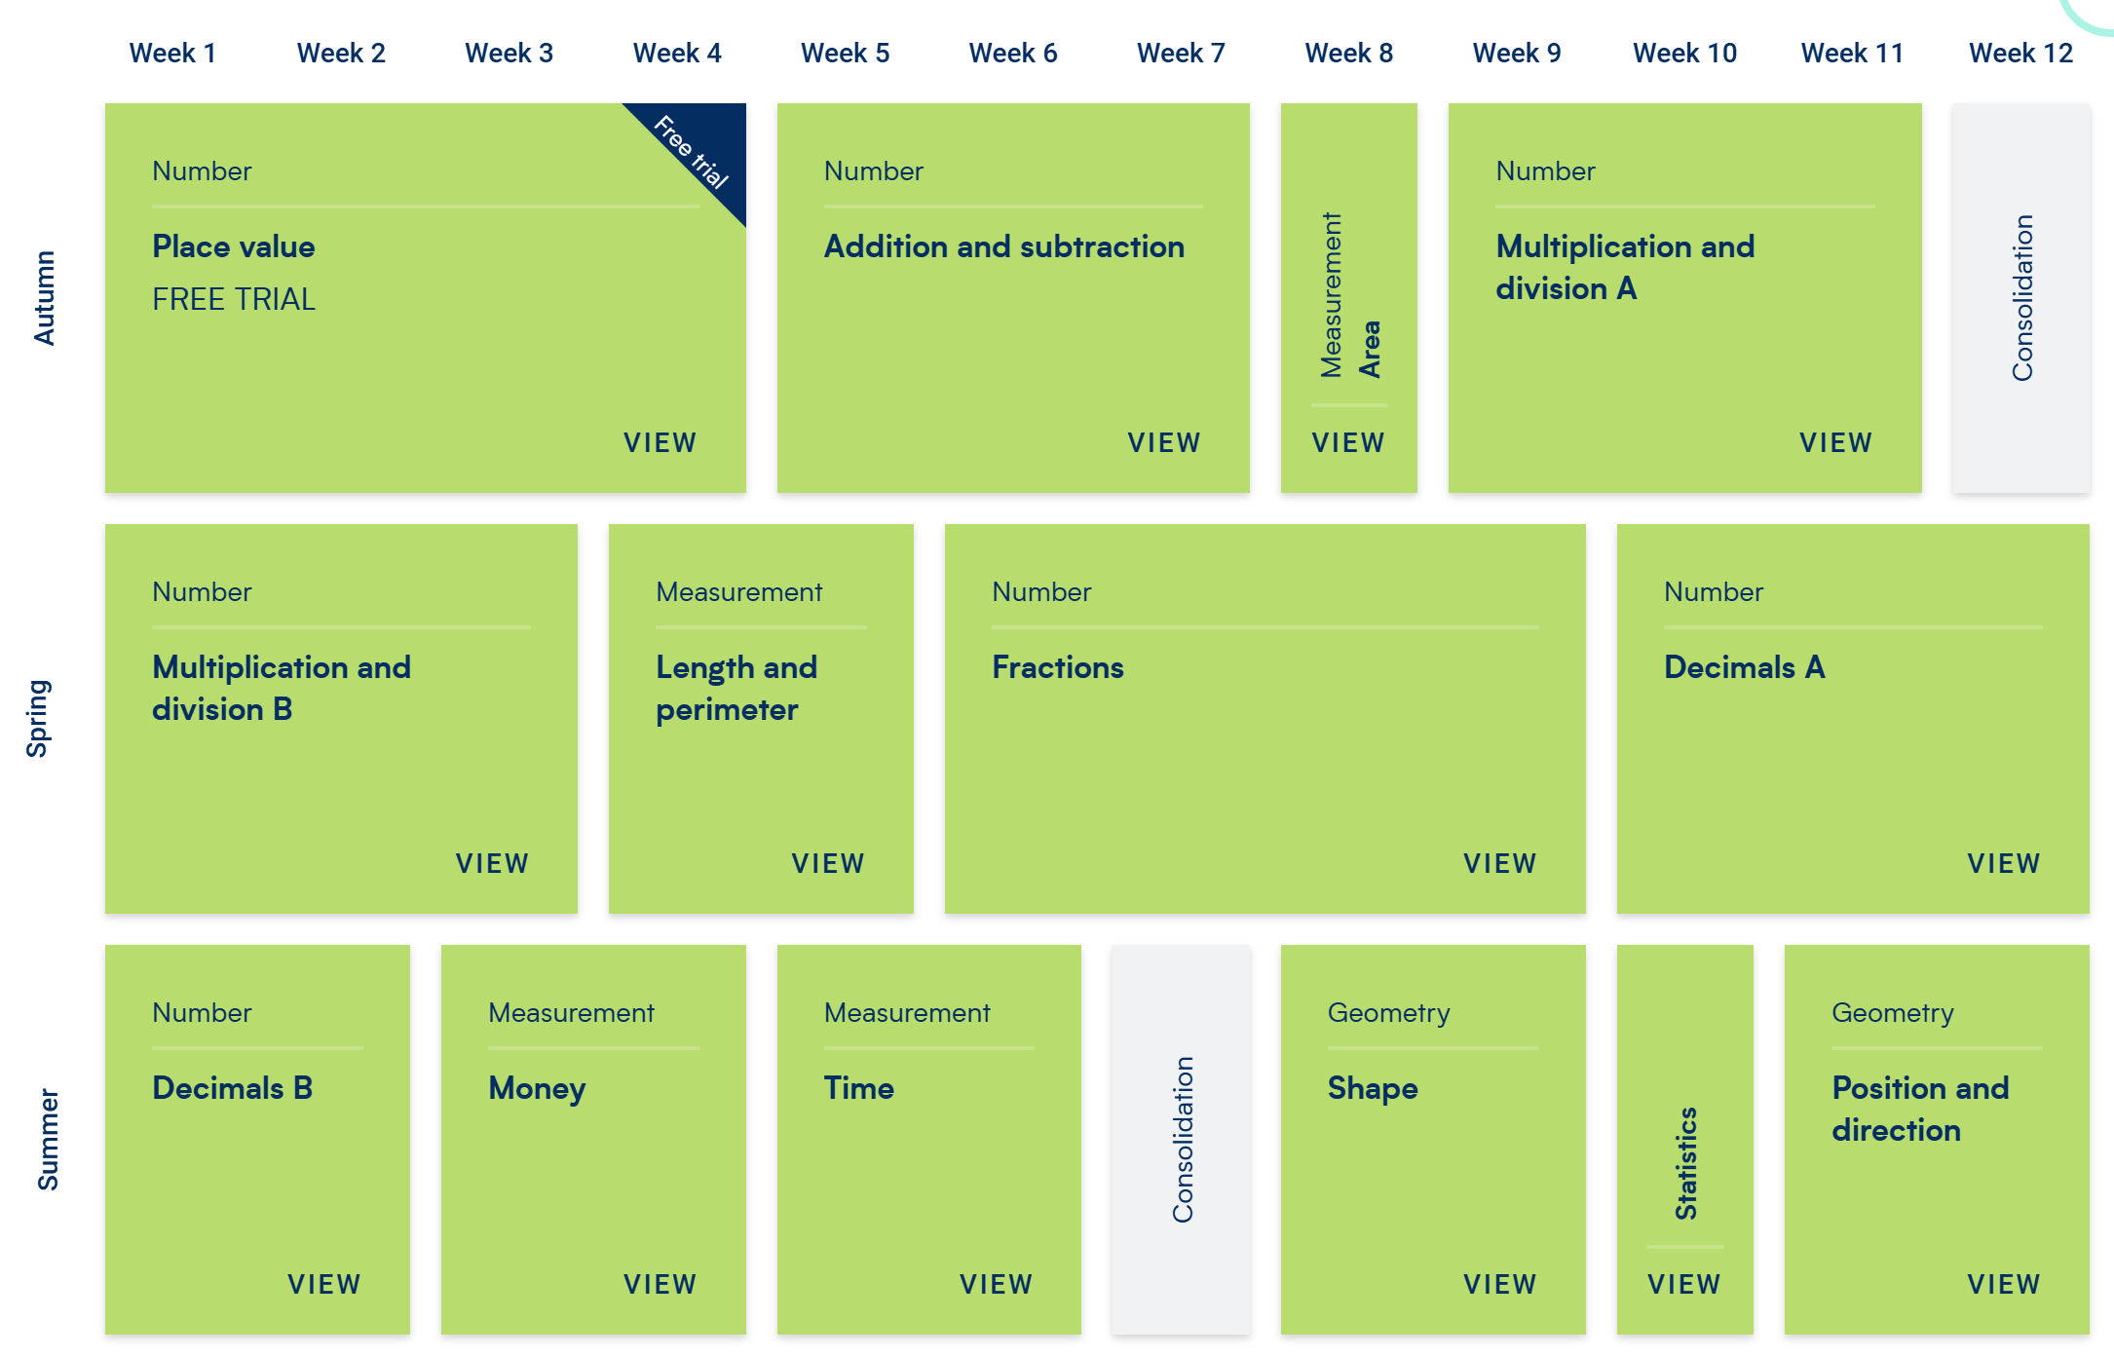
Year 4

Slide 8
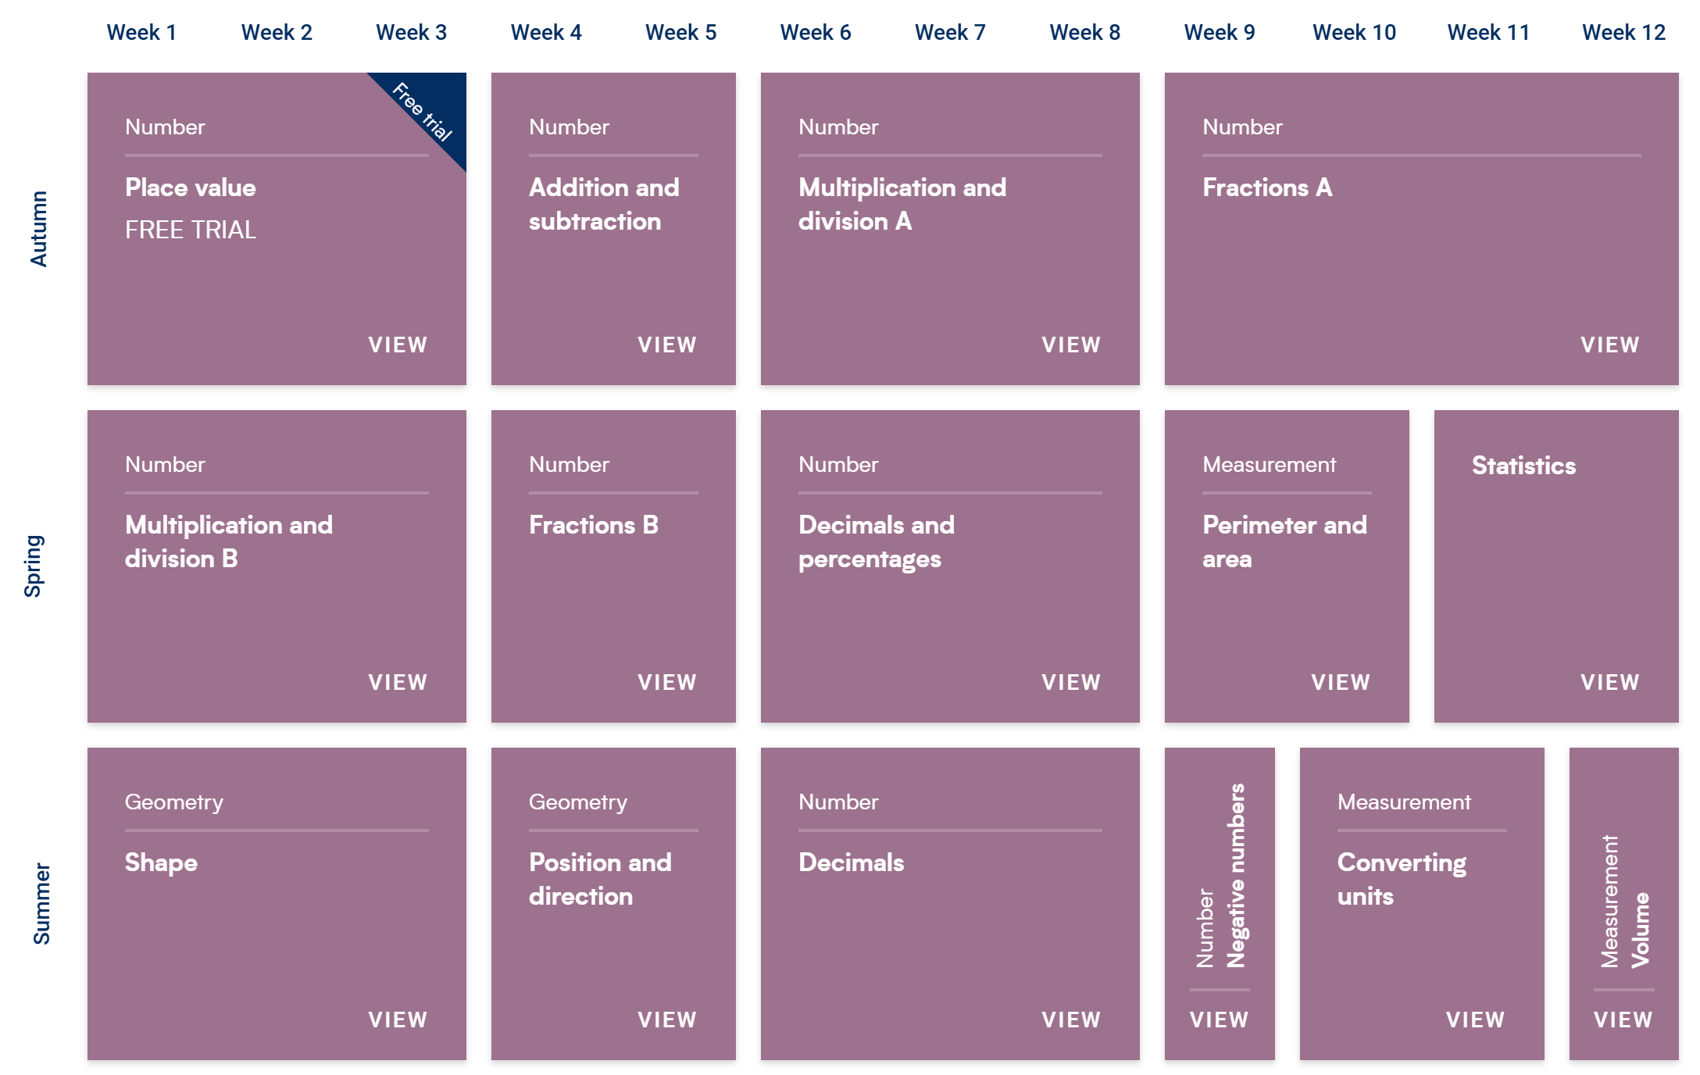
Year 5

Slide 9
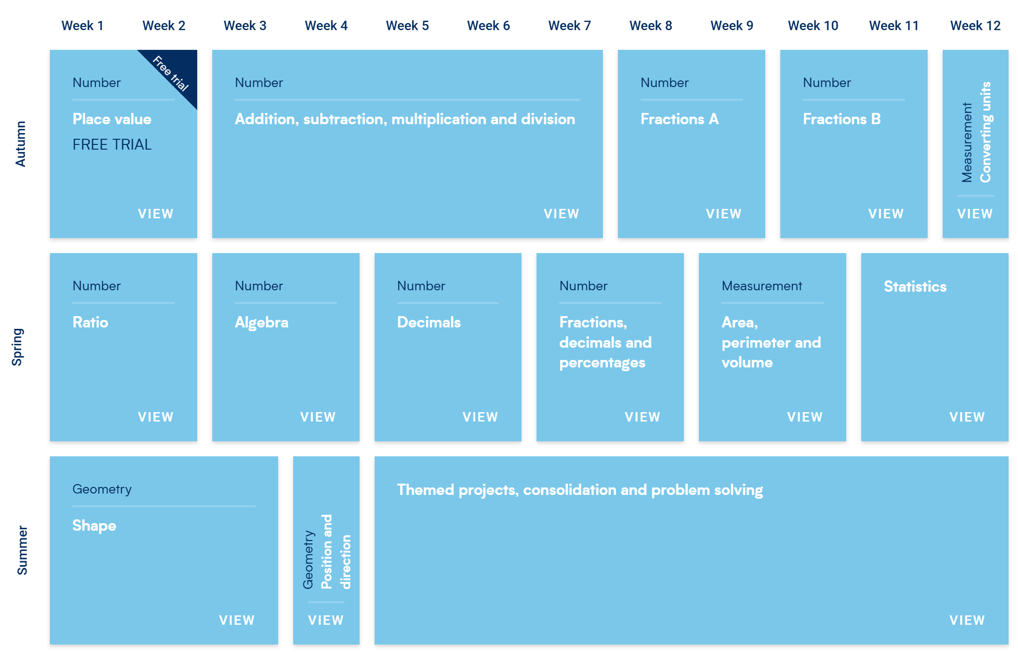
Year 6

